Slide 1
简易的计算表
陈登科

Slide 2
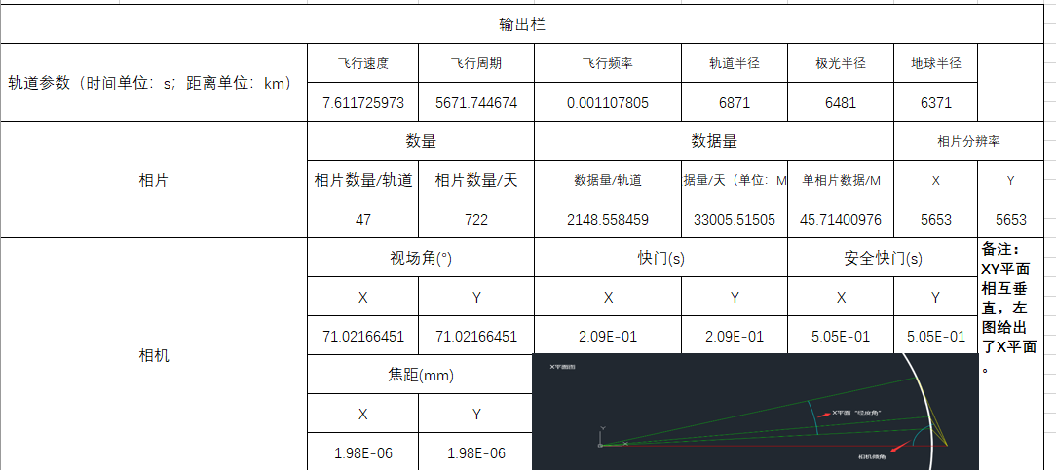

Slide 3
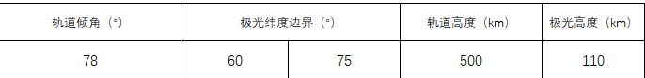

Slide 4
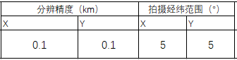
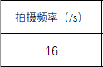
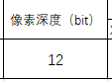
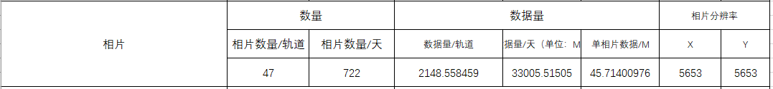
XorY
投影计算
相片数据量（Mb）≈分辨率x像素深度/8/1024
输出：

Slide 5
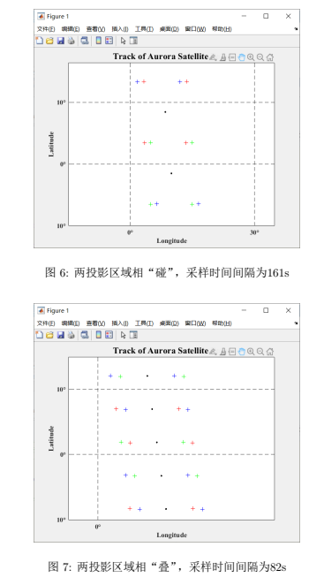
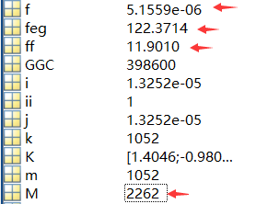
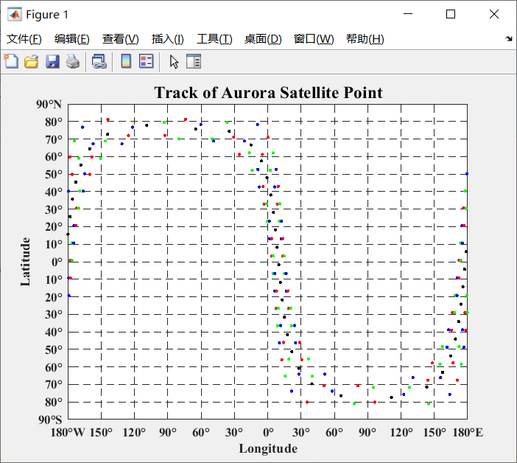
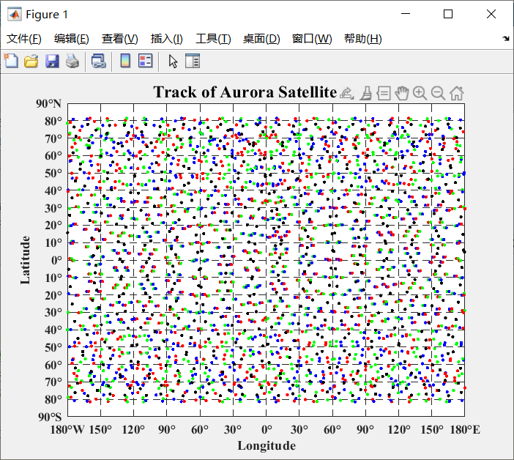
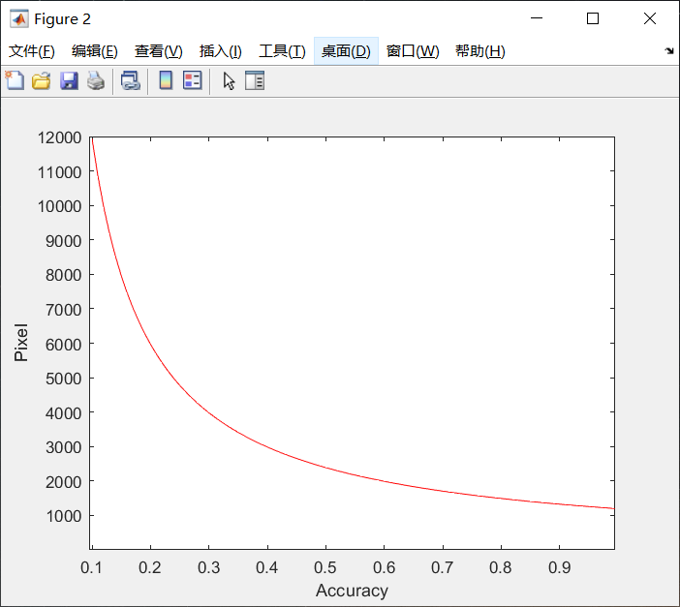
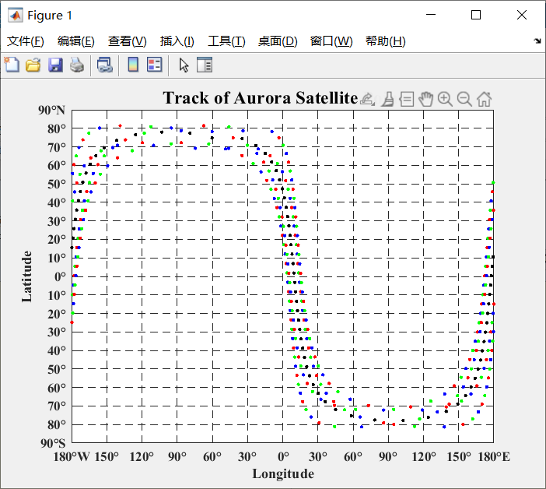
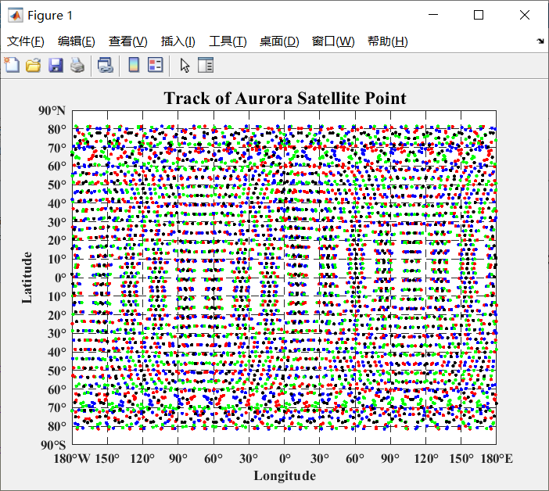
12张 117.11M
165张 1.57G
22张 214.71M
324张 3.09G

Slide 6
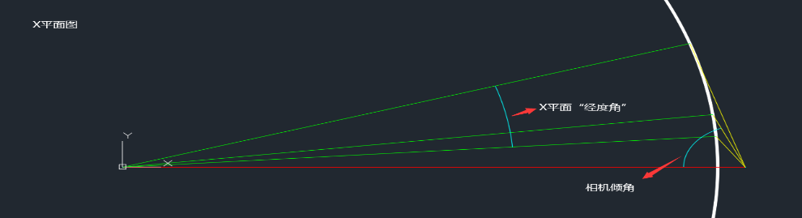
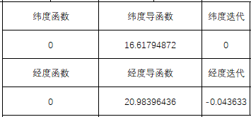
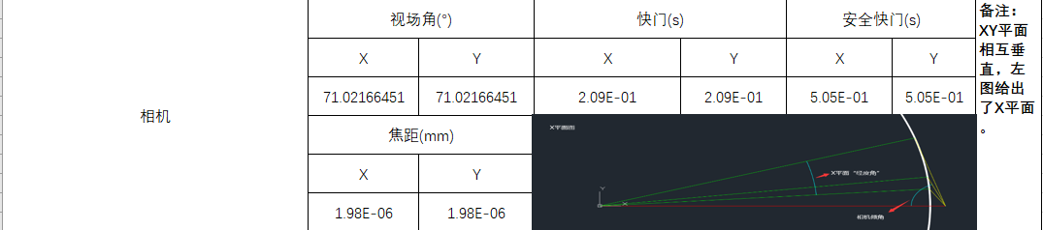
牛顿法迭代
输出：

Slide 7
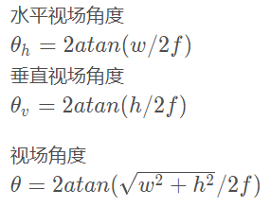
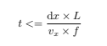
L
f
物
像屏
输出：

Slide 8
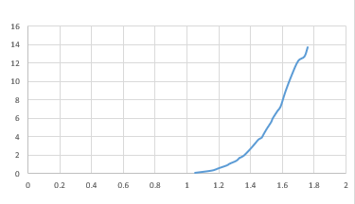
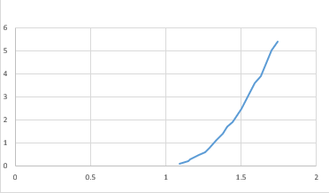
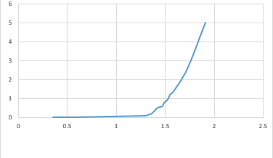
Some data
1.Gain :0~30
2.Green:557.2nm
Red:627.5nm
Blue:427.3nm
（The abscissa is in V and the ordinate is in lx）

Slide 9
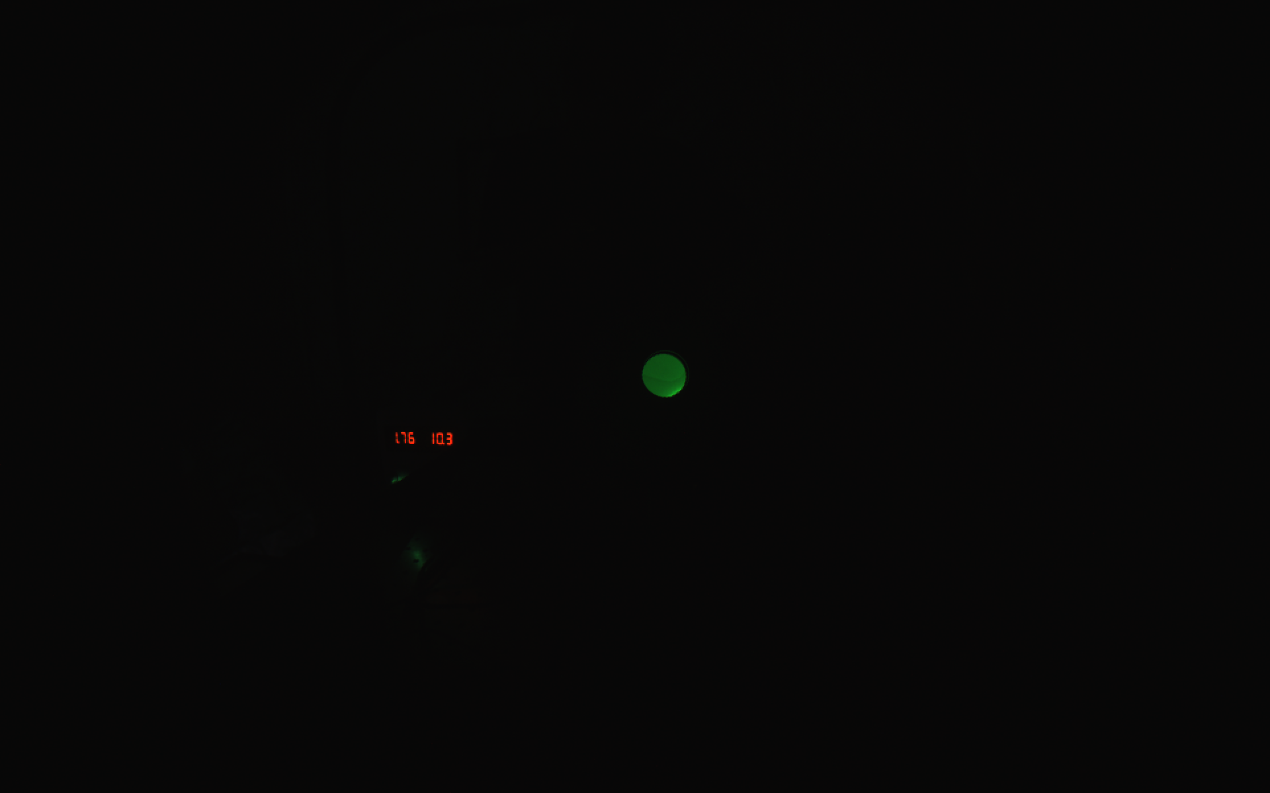
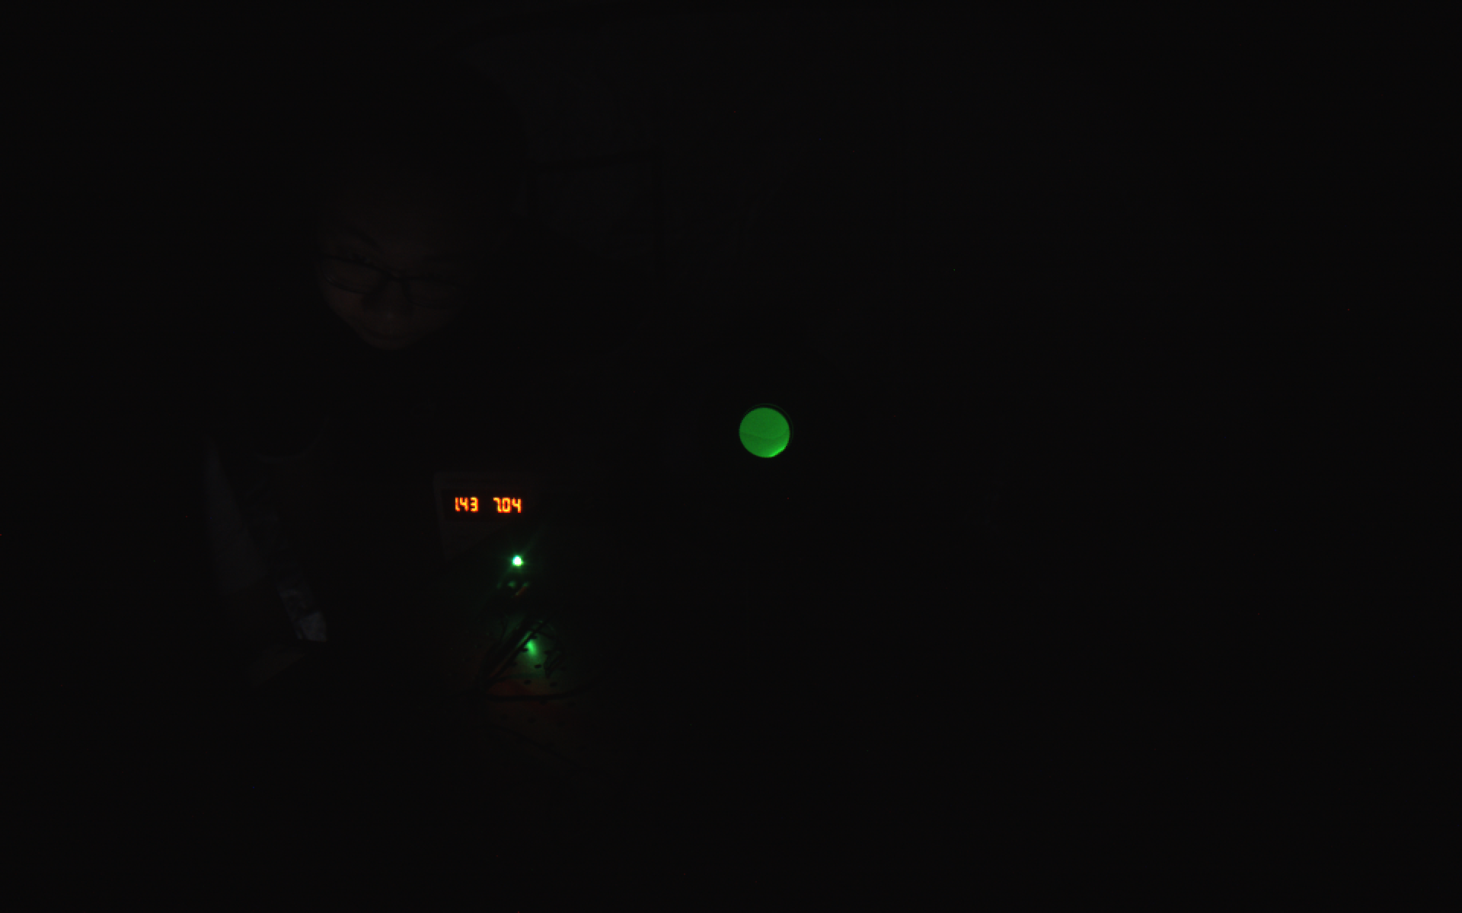
Gain
5
10
15
20
30
U/V
Max

Slide 10
Future
The gray average and variance of monochromatic photos with different gain and brightness will be analyzed, and the responsivity will be calculated.
Explore the relationship between camera gain and exposure value.
Look for patterns of light with different brightness(shutter,gain…).

